Slide 1
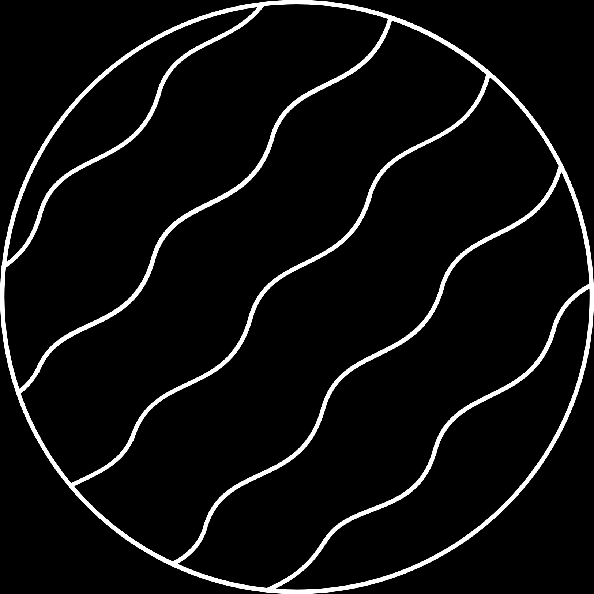
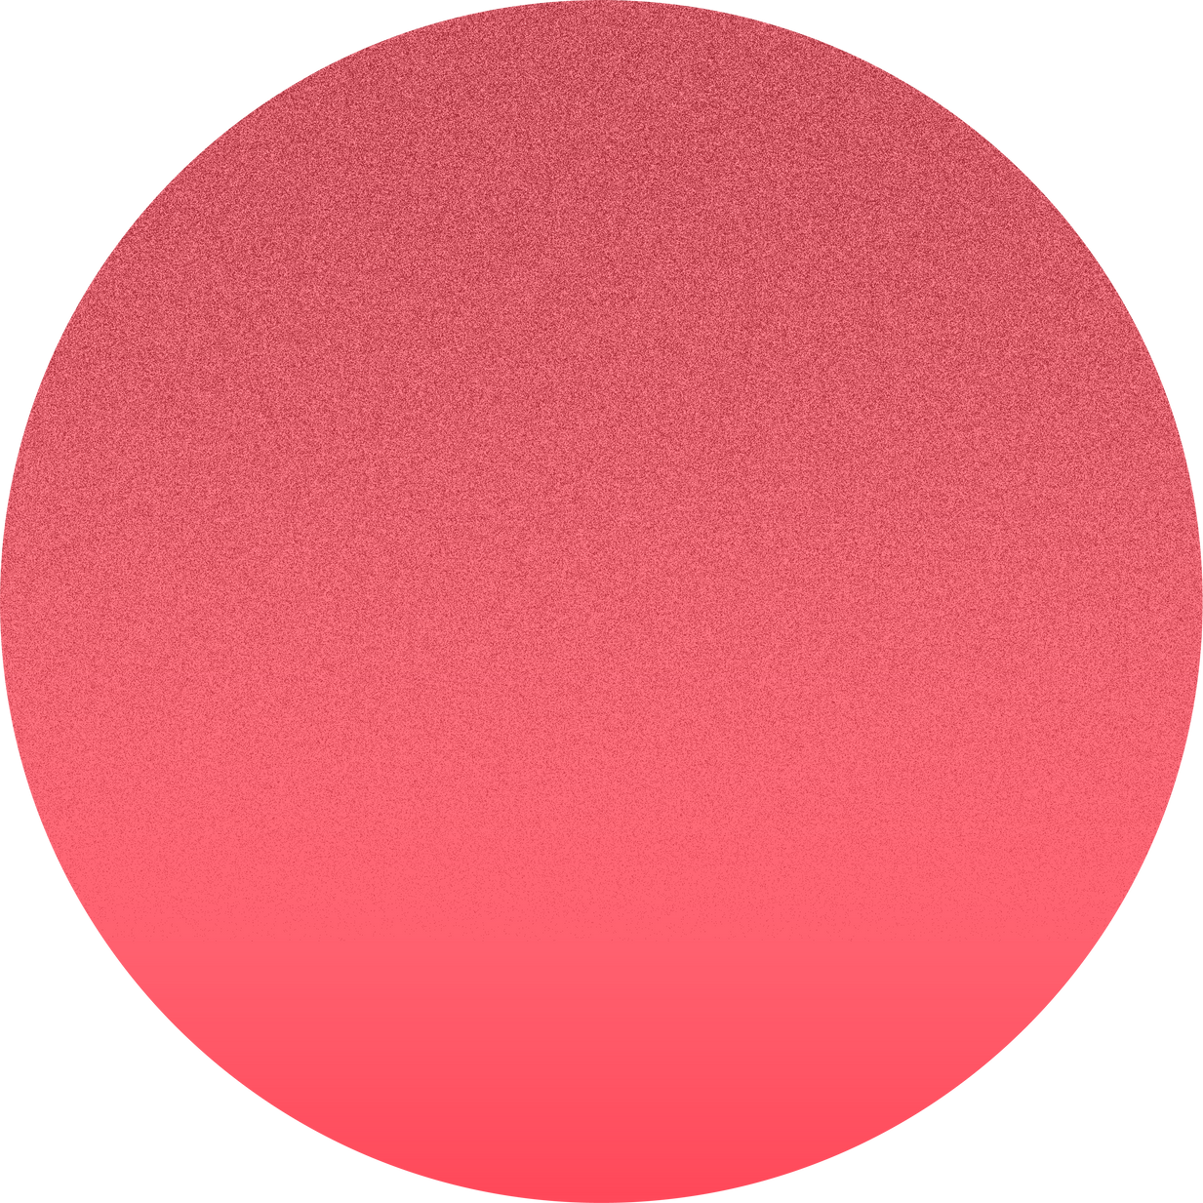

Latent Diffusion
Rama Chandra Kashyap
Kaushik Malikireddy
Haresh Ramaswamy

Slide 2

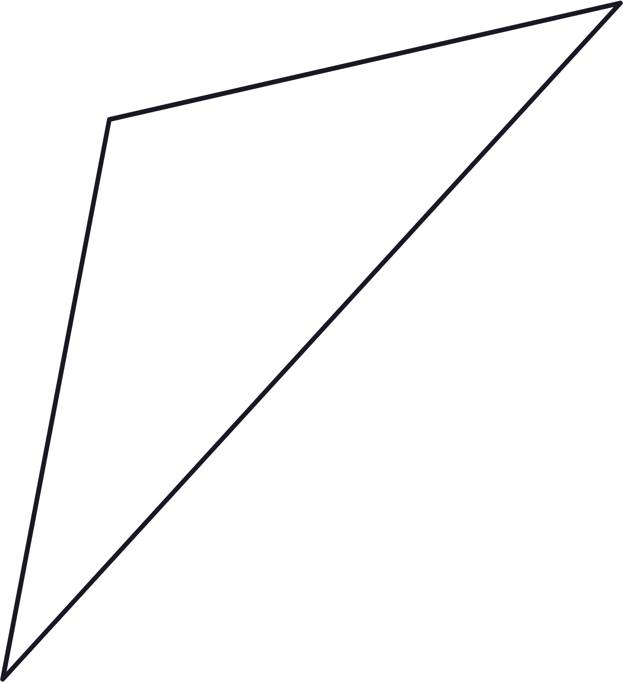
PROBLEM
STATEMENT
Build a full-stack text-to-image Generative AI web application using the Stable Diffusion architecture, where only the U-Net diffusion model is fine-tuned on a custom image-caption dataset while keeping the pre-trained CLIP tokenizer and VAE encoder-decoder components frozen

Slide 3

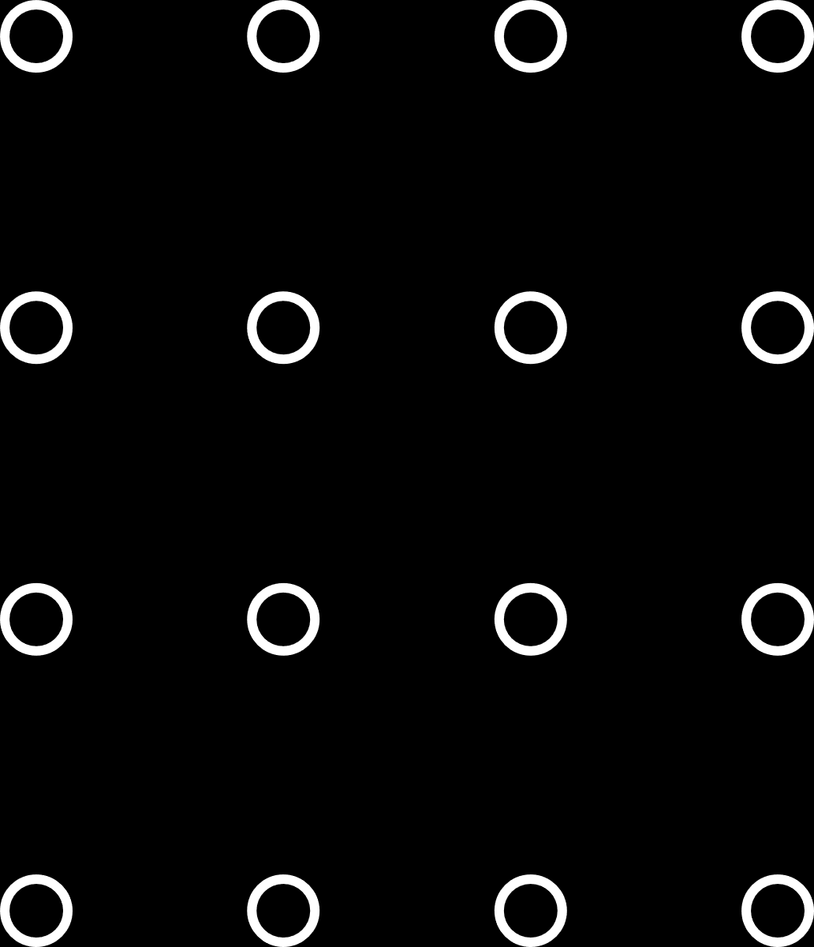
DATASET
Contains 1,200+ Naruto-style images sourced from narutopedia.com ( 700 MB)
Each image is paired with a BLIP-generated caption (text + PIL JPEG)
Provided as a train-only split, ideal for fine-tuning diffusion models
Captions include stylized prompts like "Banksy street art of ninja"
https://huggingface.co/datasets/lambdalabs/naruto-blip-captions

Slide 4
Approach
CLIP
ENCODER
DECODER
UNET
FINE-TUNING
CLIP tokenizer converts text into embeddings that capture semantic relationships between text and images, enabling effective text-to-image generation.
The VAE decoder reconstructs images from latent representations, enabling new image generation based on compressed data.
U-Net, through iterative denoising, is used in diffusion models to generate high-quality images from random noise.
Fine-tuning the diffusion model with an image-caption dataset improves the alignment of generated images with textual prompts while keeping encoder weights frozen.
The VAE encoder compresses images into a latent space, facilitating efficient image manipulation and generation.

Slide 5
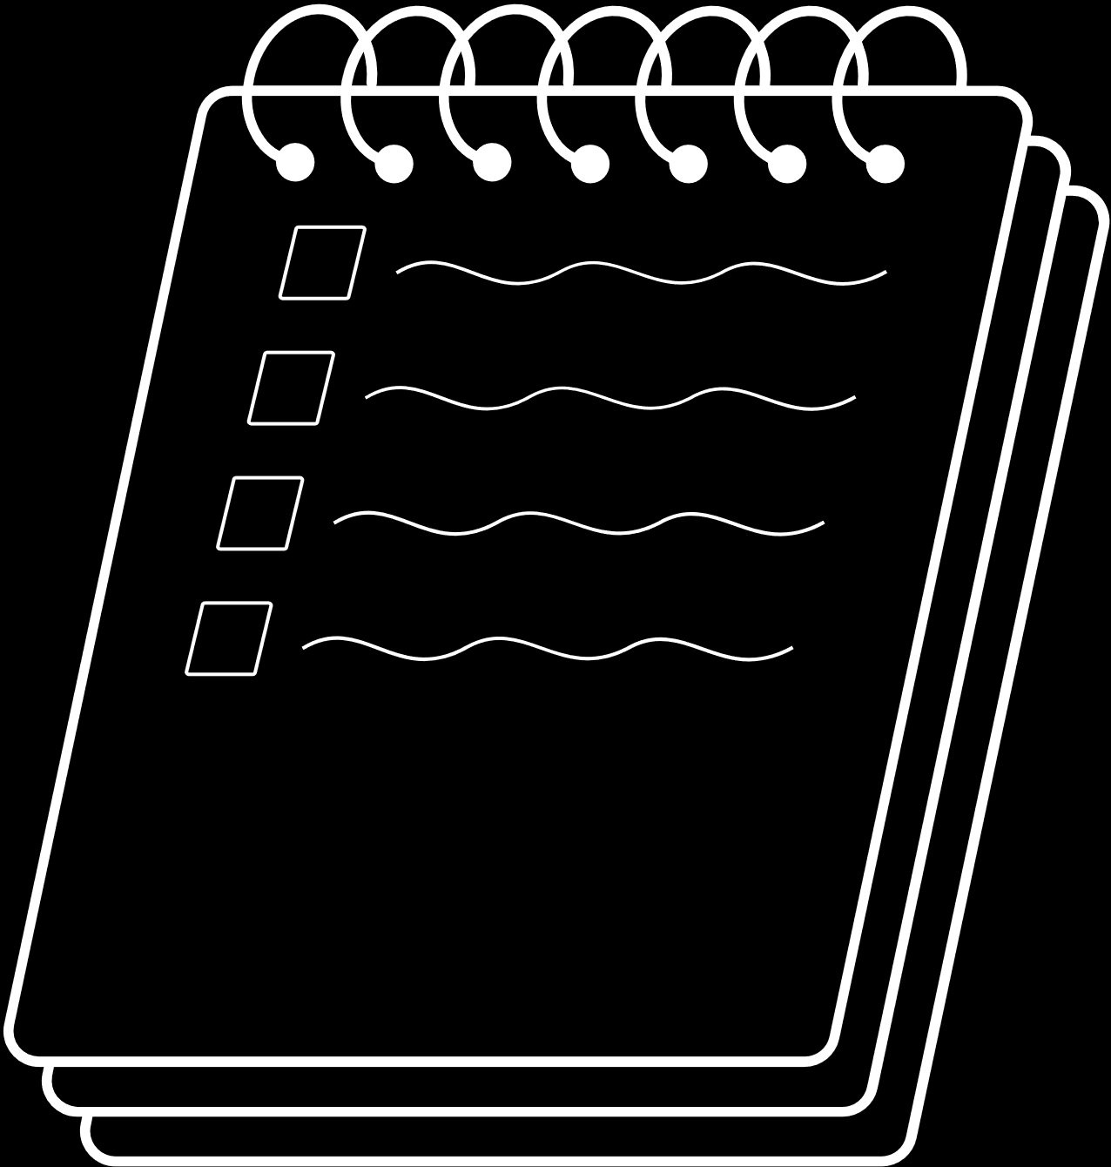
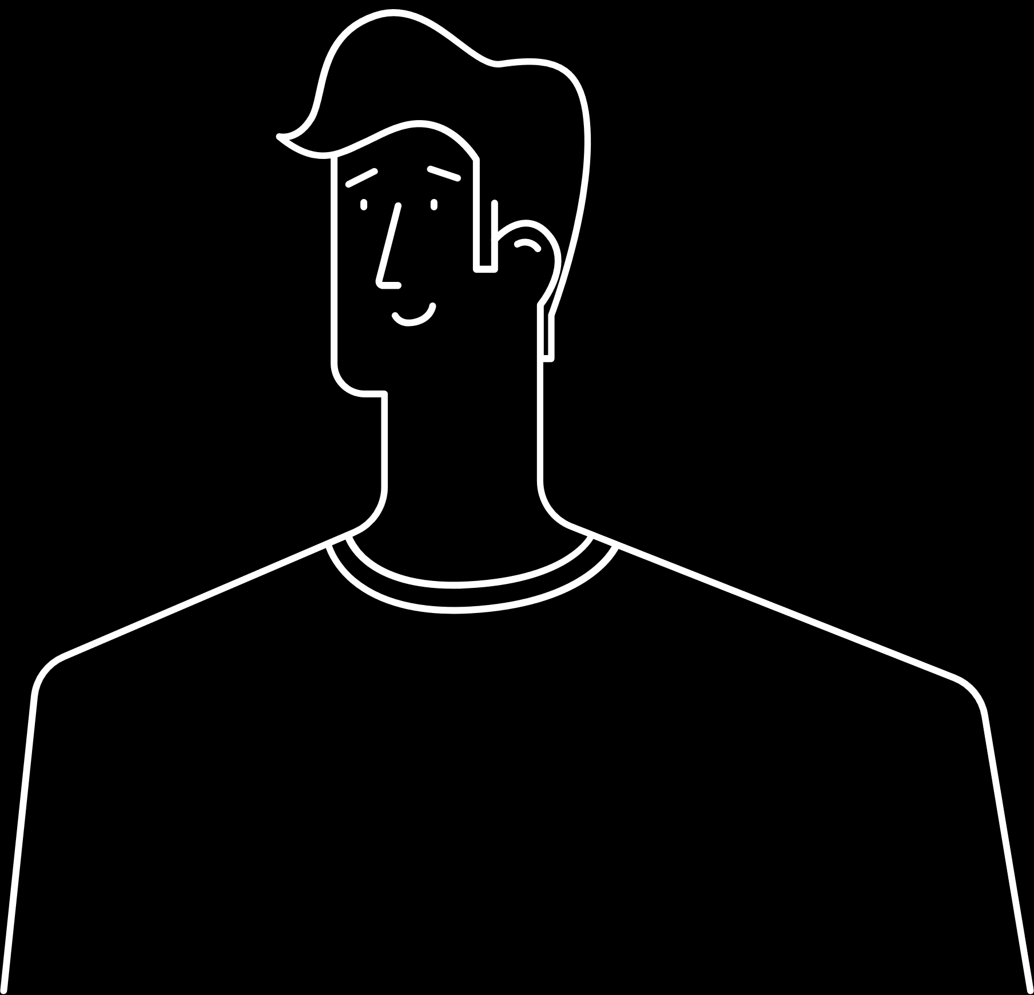

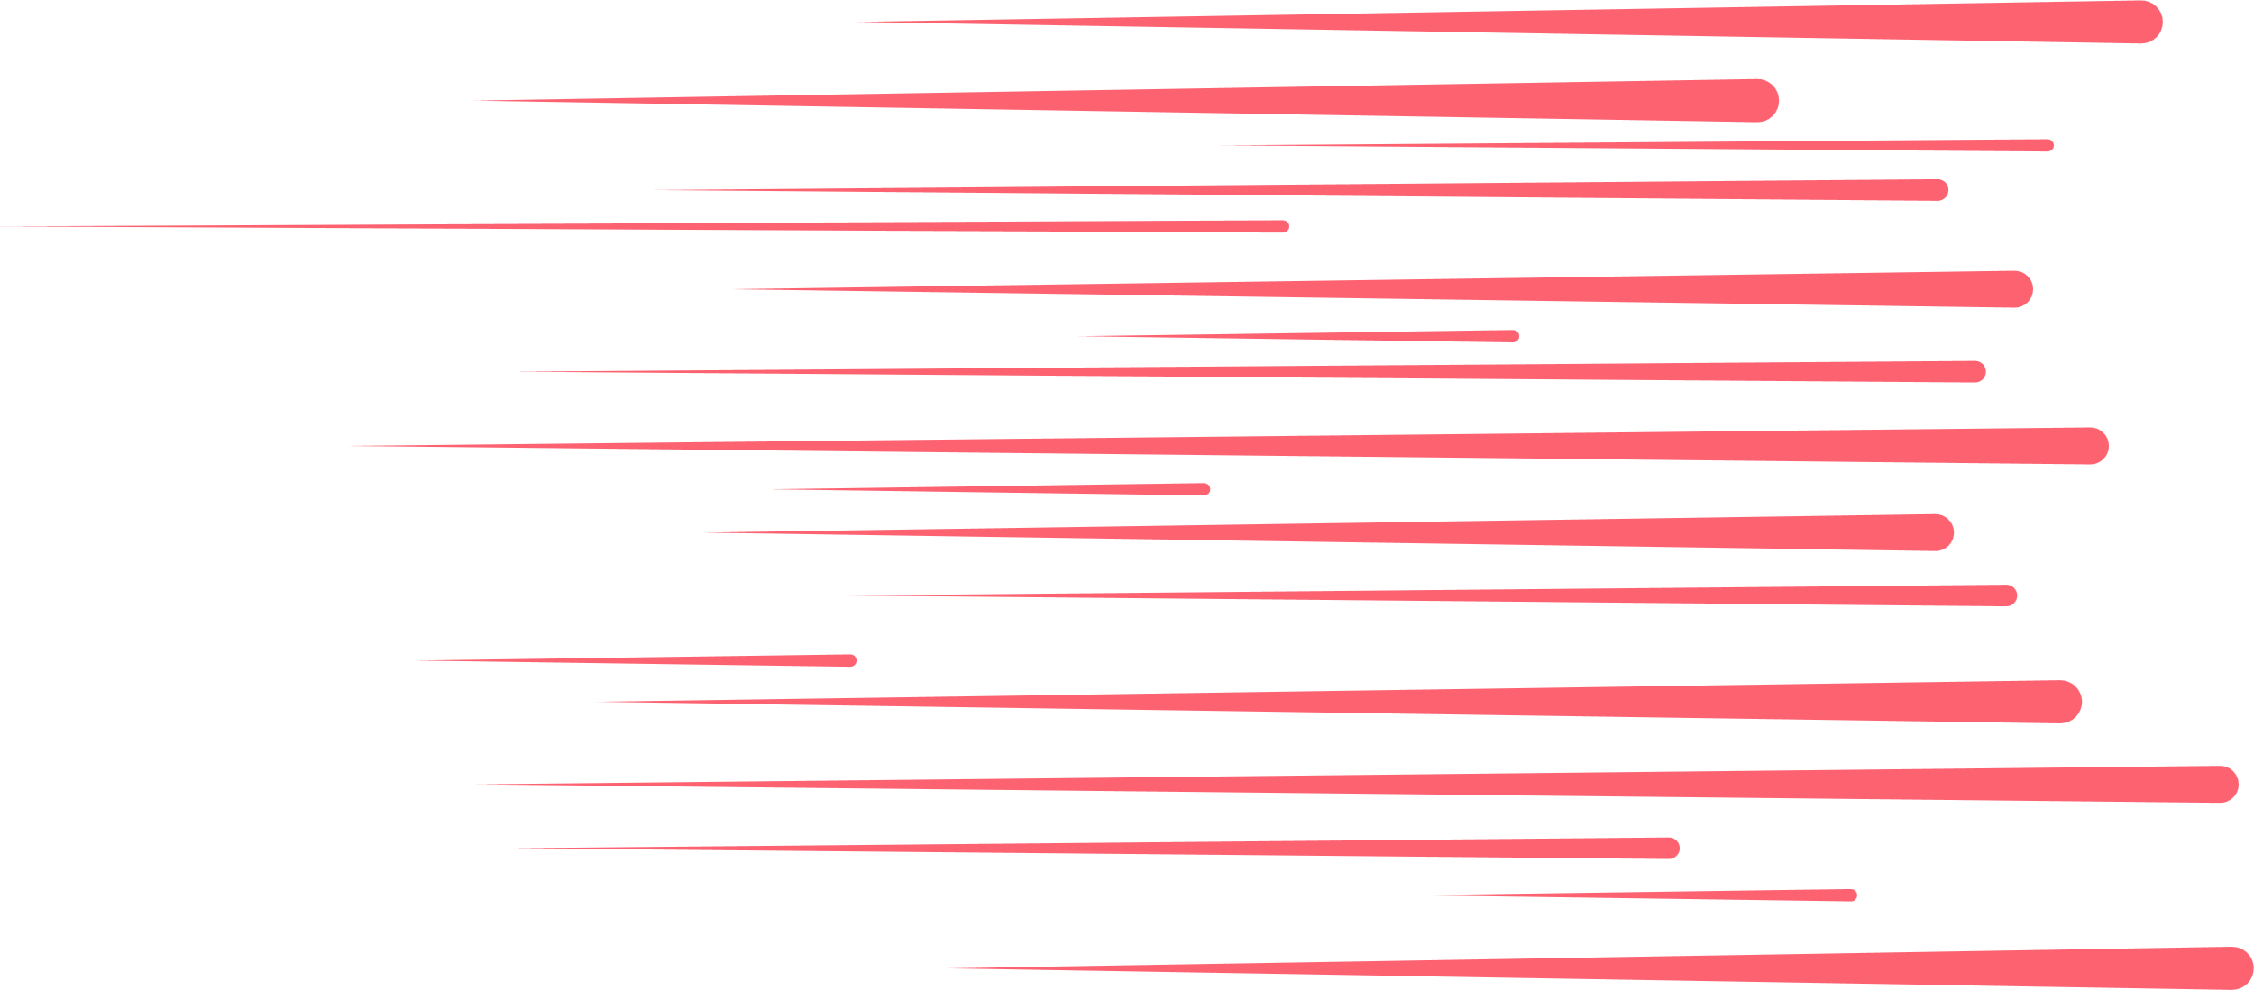
Latent Diffusion is a technique that generates images by operating in a compressed latent space instead of pixel space, making it more efficient and scalable.
WHAT IS LATENT
DIFFUSION ?
Put Simply : It’s like sketching a rough blueprint (latent space) before painting the full artwork — faster and easier than working on the full canvas from the start.
NO
CLUE
GETS
IT !

Slide 6
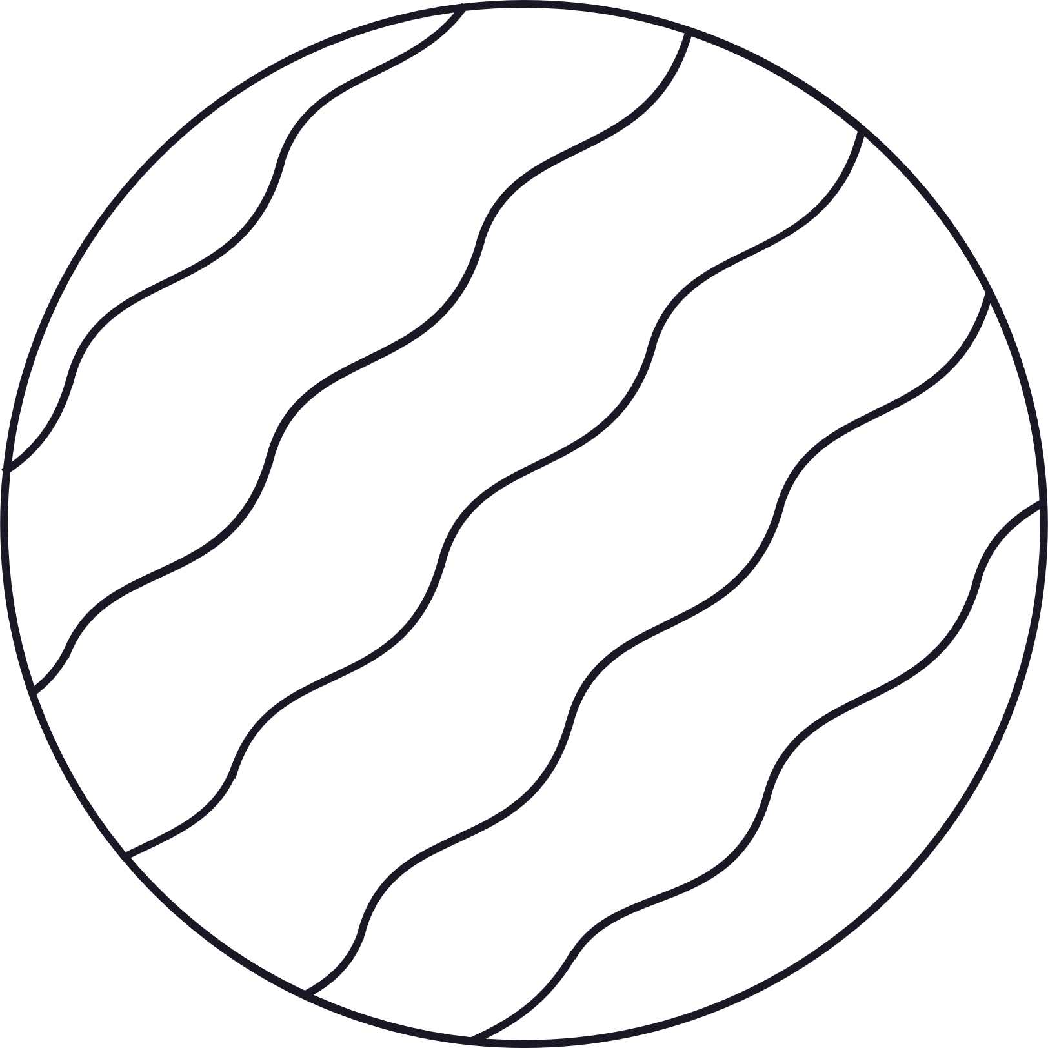


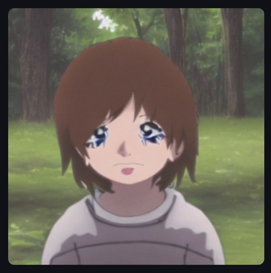

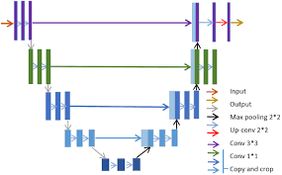
Implementation
FINE-TUNING
A CHILD WITH BROWN HAIR AND BLUE EYES
CLIP
ENCODER
DECODER
UNET

Slide 7
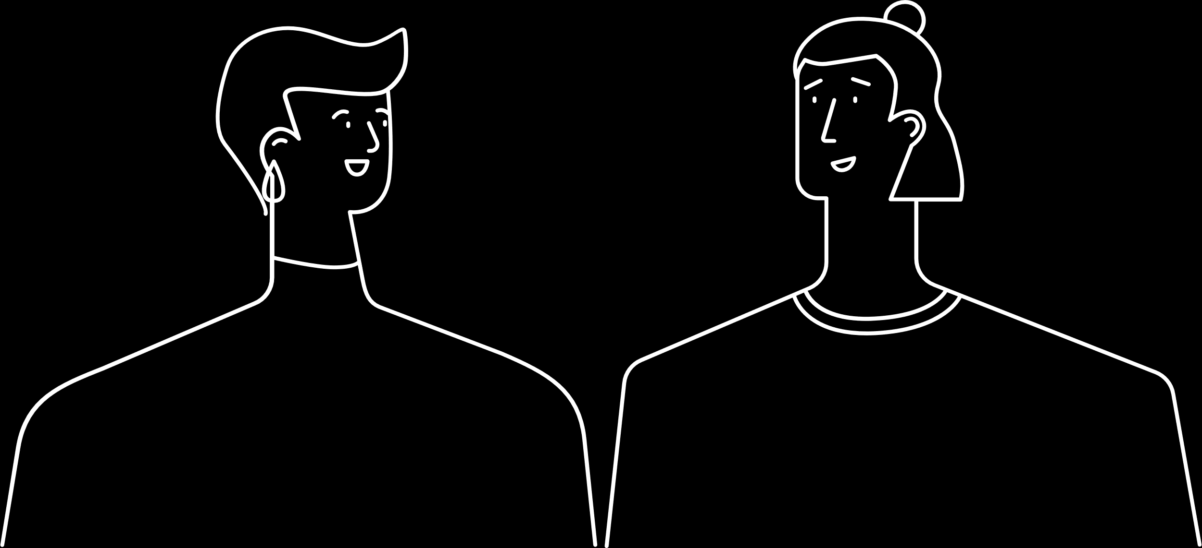
OUR PRE-TRAINED MODELS
Stable diffusion v1.5 :
A powerful text-to-image LDM by Stability AI.
Trained on millions of image–text pairs to create realistic or artistic images from any prompt.
Uses a smart text reader (CLIP) and a noise-removing model (U-Net).
Has around 1.25 billion parameters.
Best use cases include Art, design, fantasy scenes, concepts
Mo-Di-Diffusion:
A fine-tuned version of Stable Diffusion made by Nitrosocke.
Specially trained to create images in a “modern Disney” style.
Has 1.25B parameters
Trained using DreamBooth with 9,000 steps.
Works well for cartoon-like characters, animals and scenes.

Slide 8
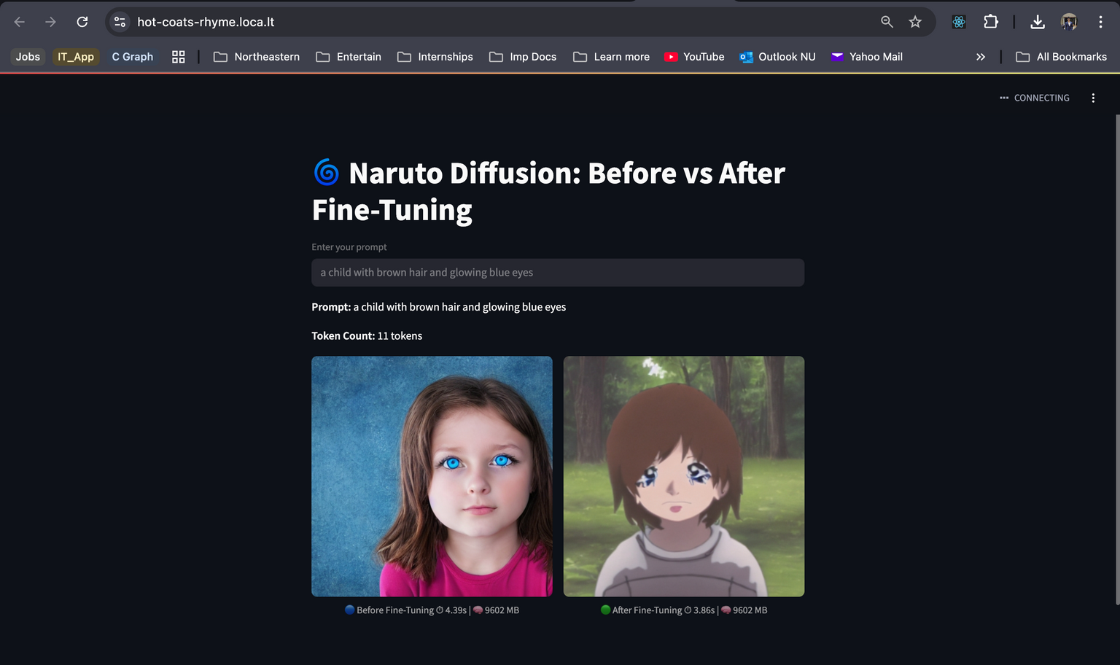
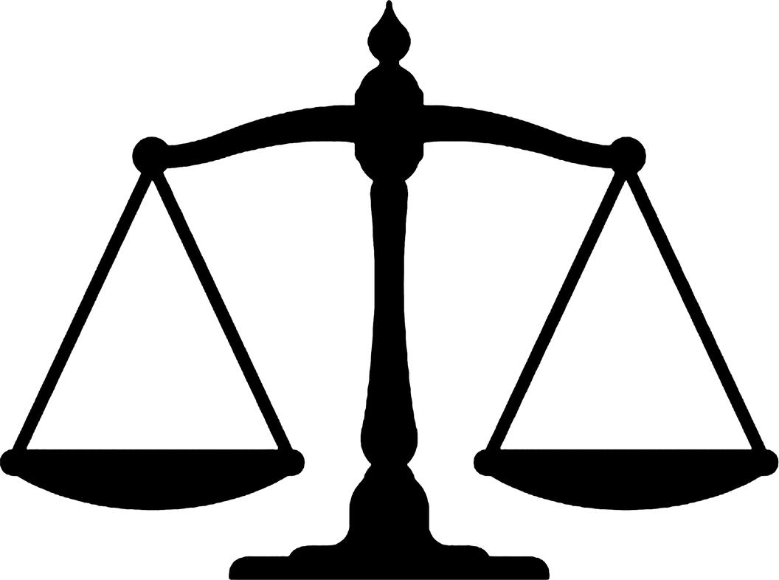
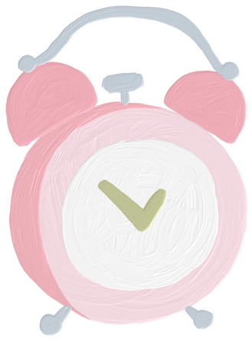

STREAMLIT UI
Combination of Backend + Frontend + Deployment

Slide 9
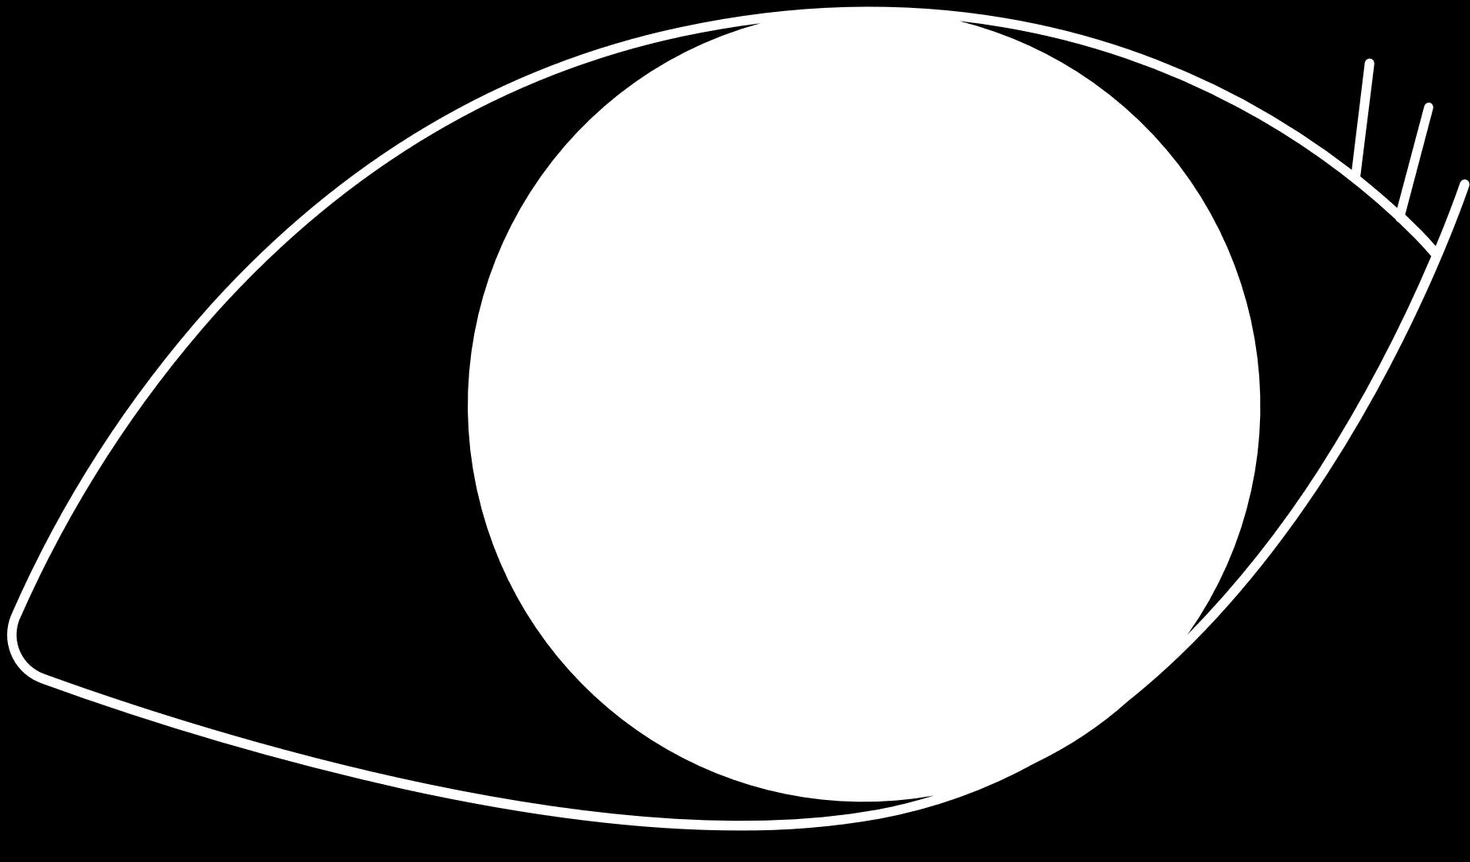
HERE ARE SOME PREDICTIONS

Slide 10
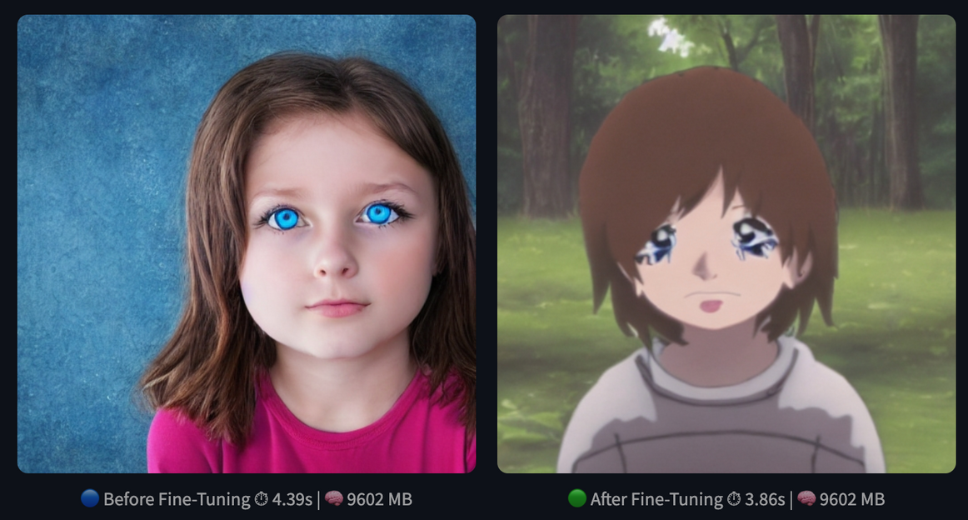
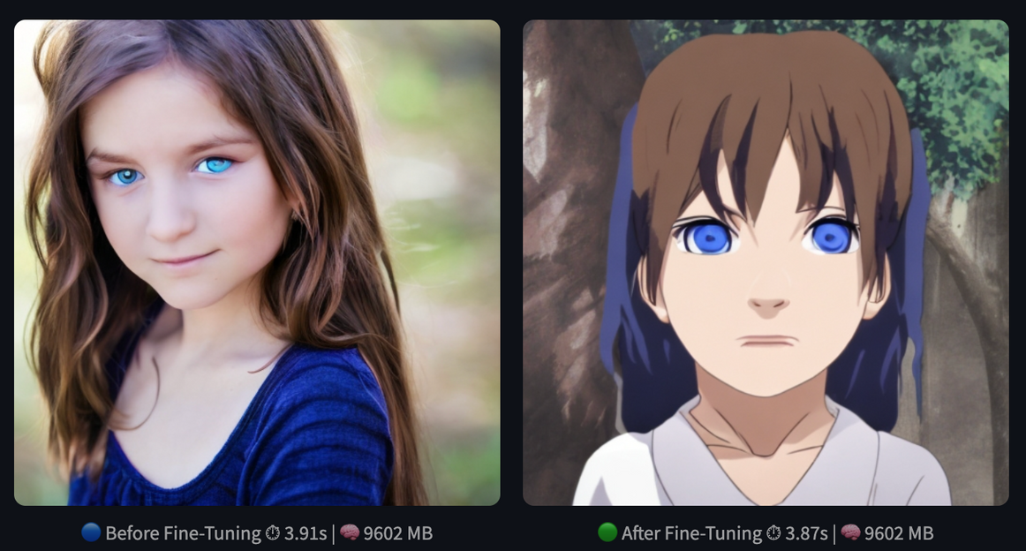
STABLE DIFFUSION V1-5
MO DI DIFFUSION
10 Epcochs
5 Epochs

Slide 11
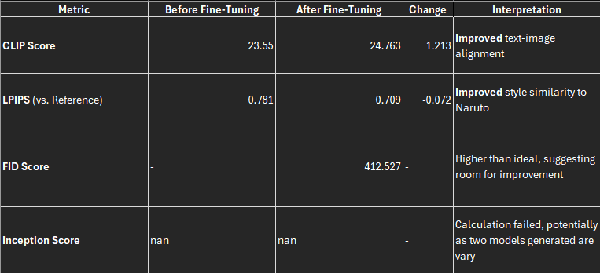
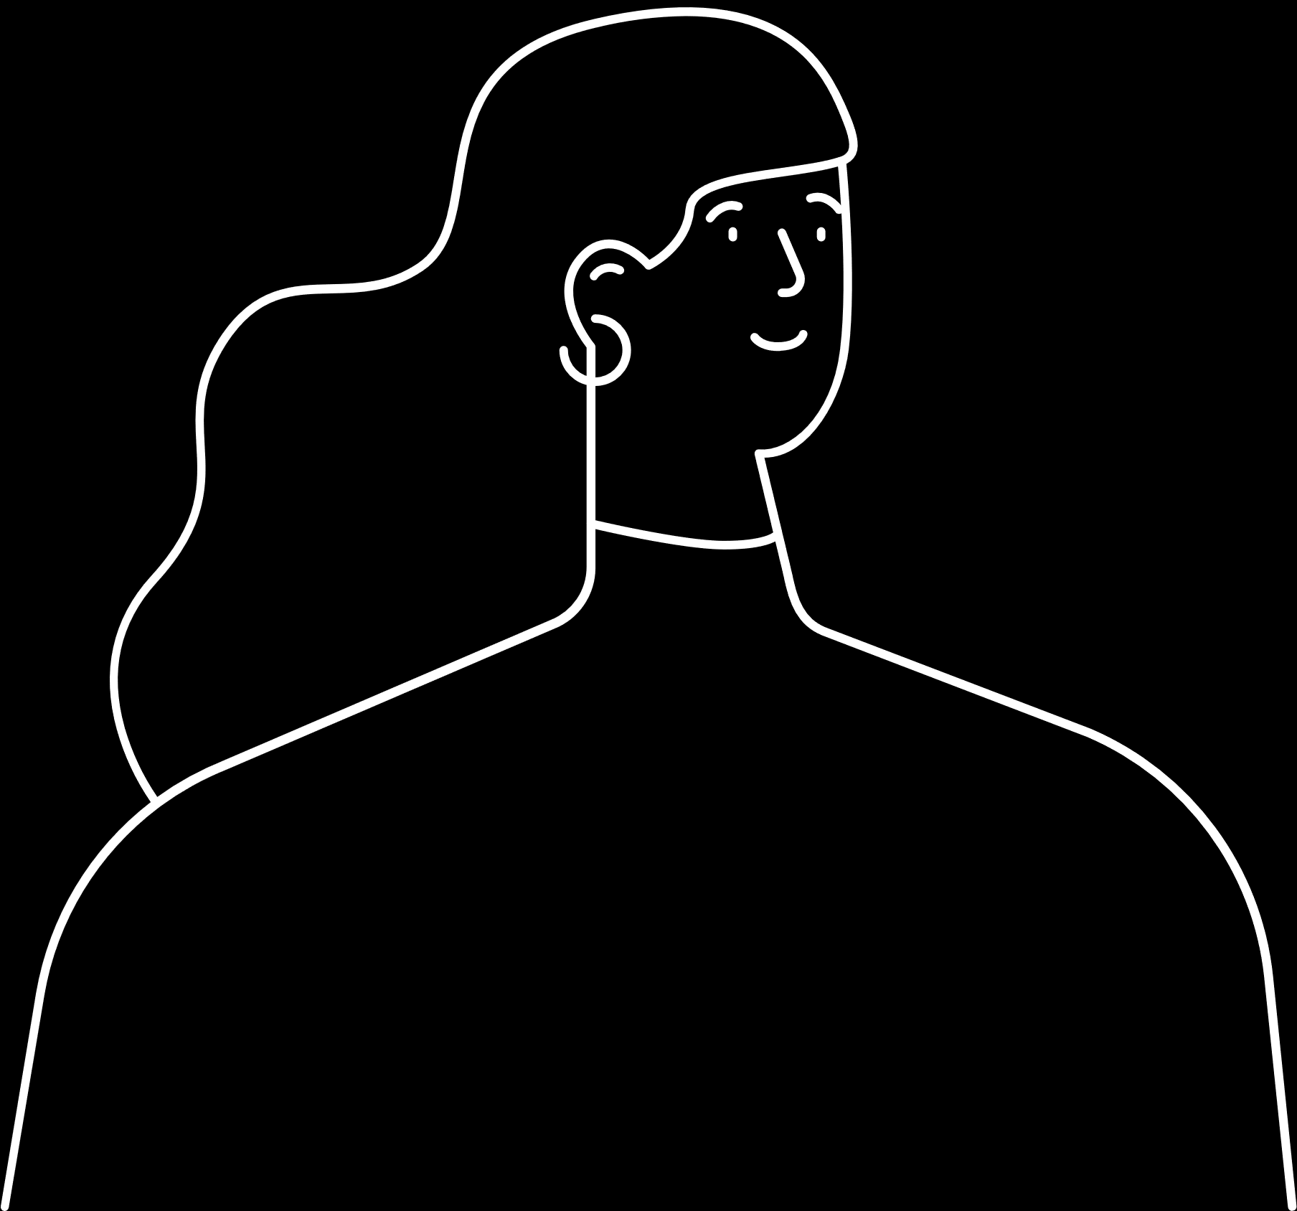
Evaluation

Slide 12


11
Thank you

